Slide 1
Conagra Data Analysis Project
UTD BUAN 6337
Predictive Analytics
Professor: Shervin Tehrani
Spring 2024
Group 31:
Divya Rajesh Kannan
Zach Landry
Phuc Minh Le
Annastacia Marchand
Sri Sai Sashank Pyneni
Dilshan Weerasinghe

Slide 2
Overview
Problem Statement: How can Conagra increase sales across the United States?
Our Recommendation: Conagra should adopt a region-specific approach to promotions, product forms and flavors.

Slide 3
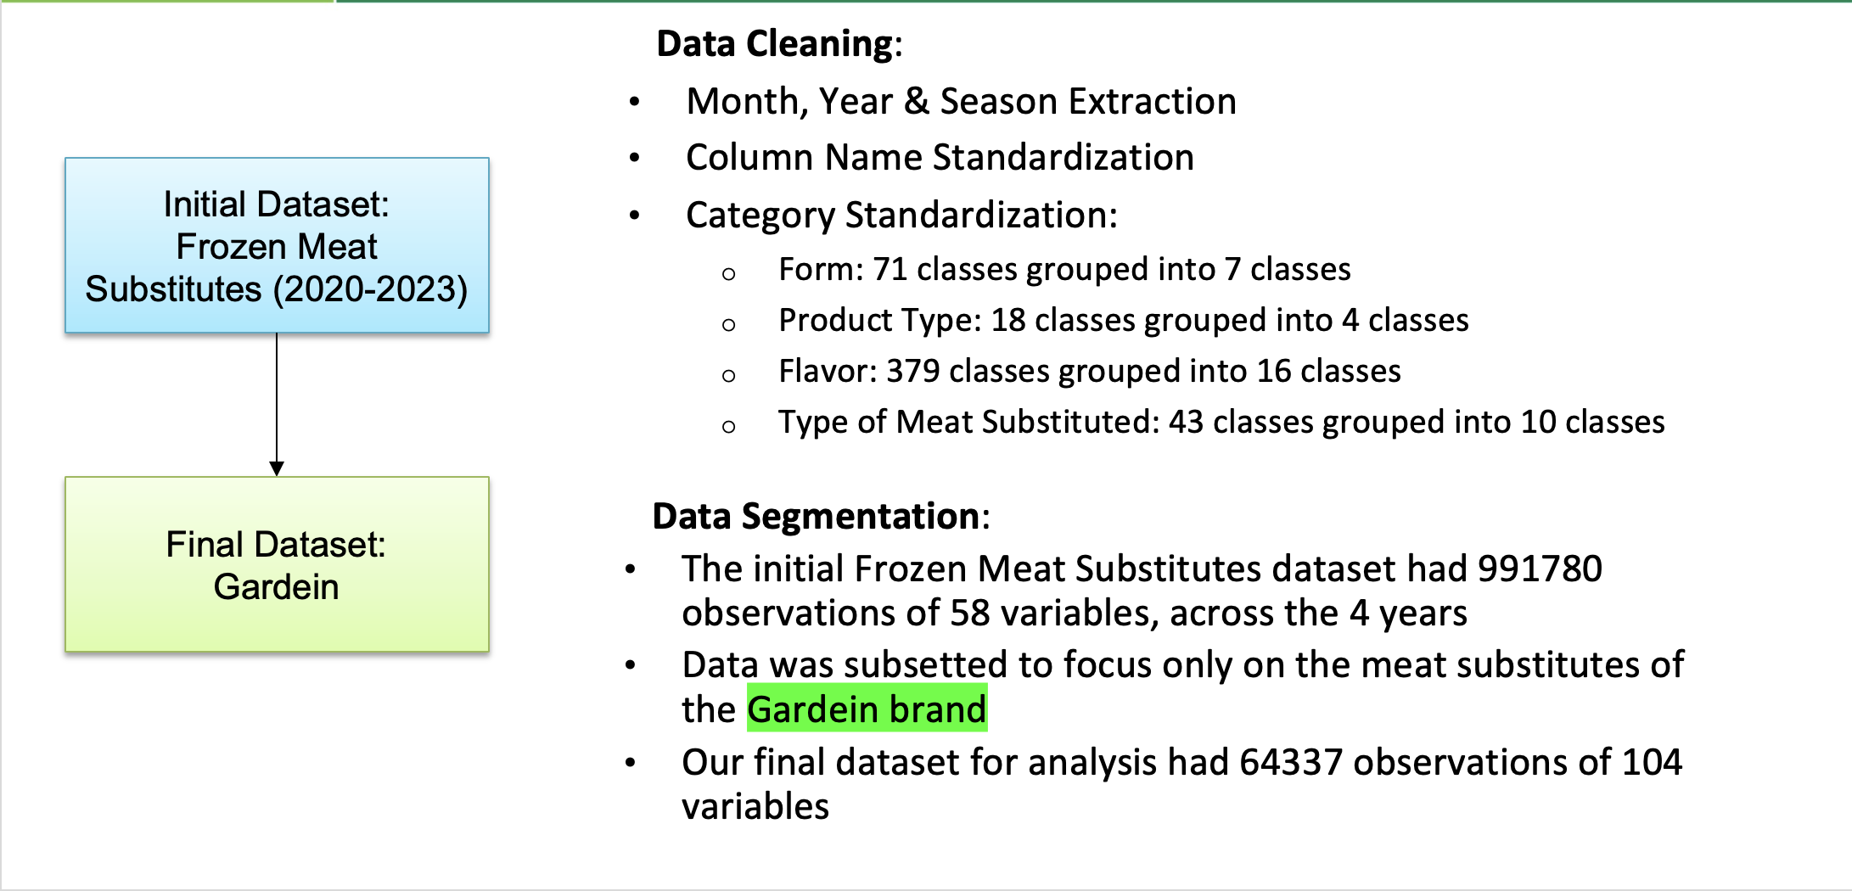
Understanding the Data

Slide 4
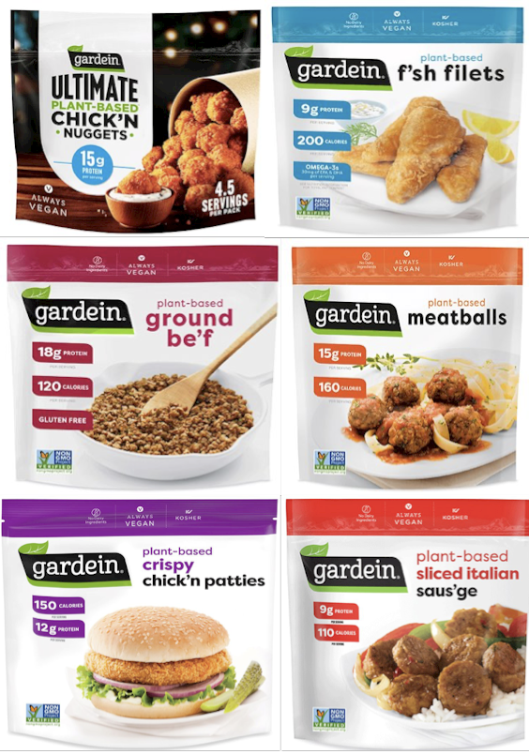
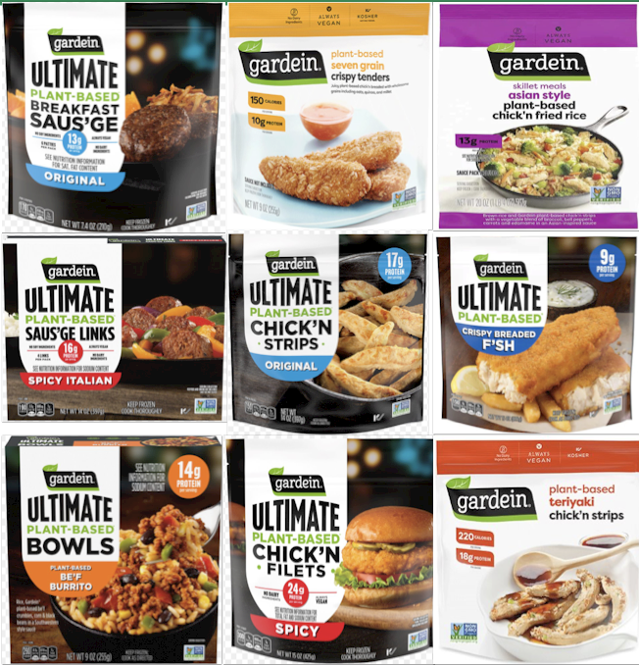
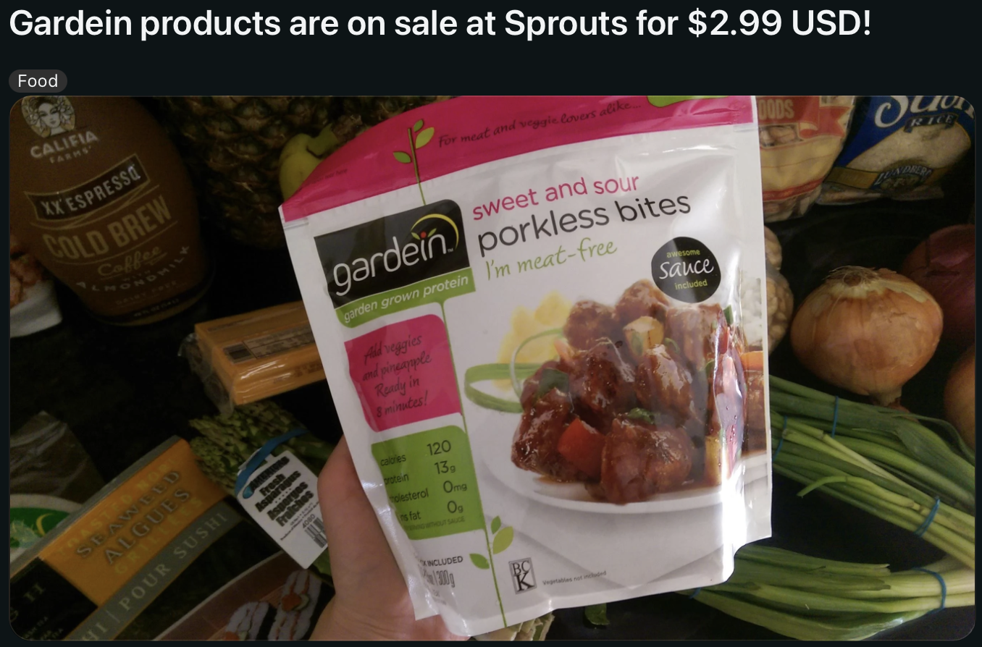
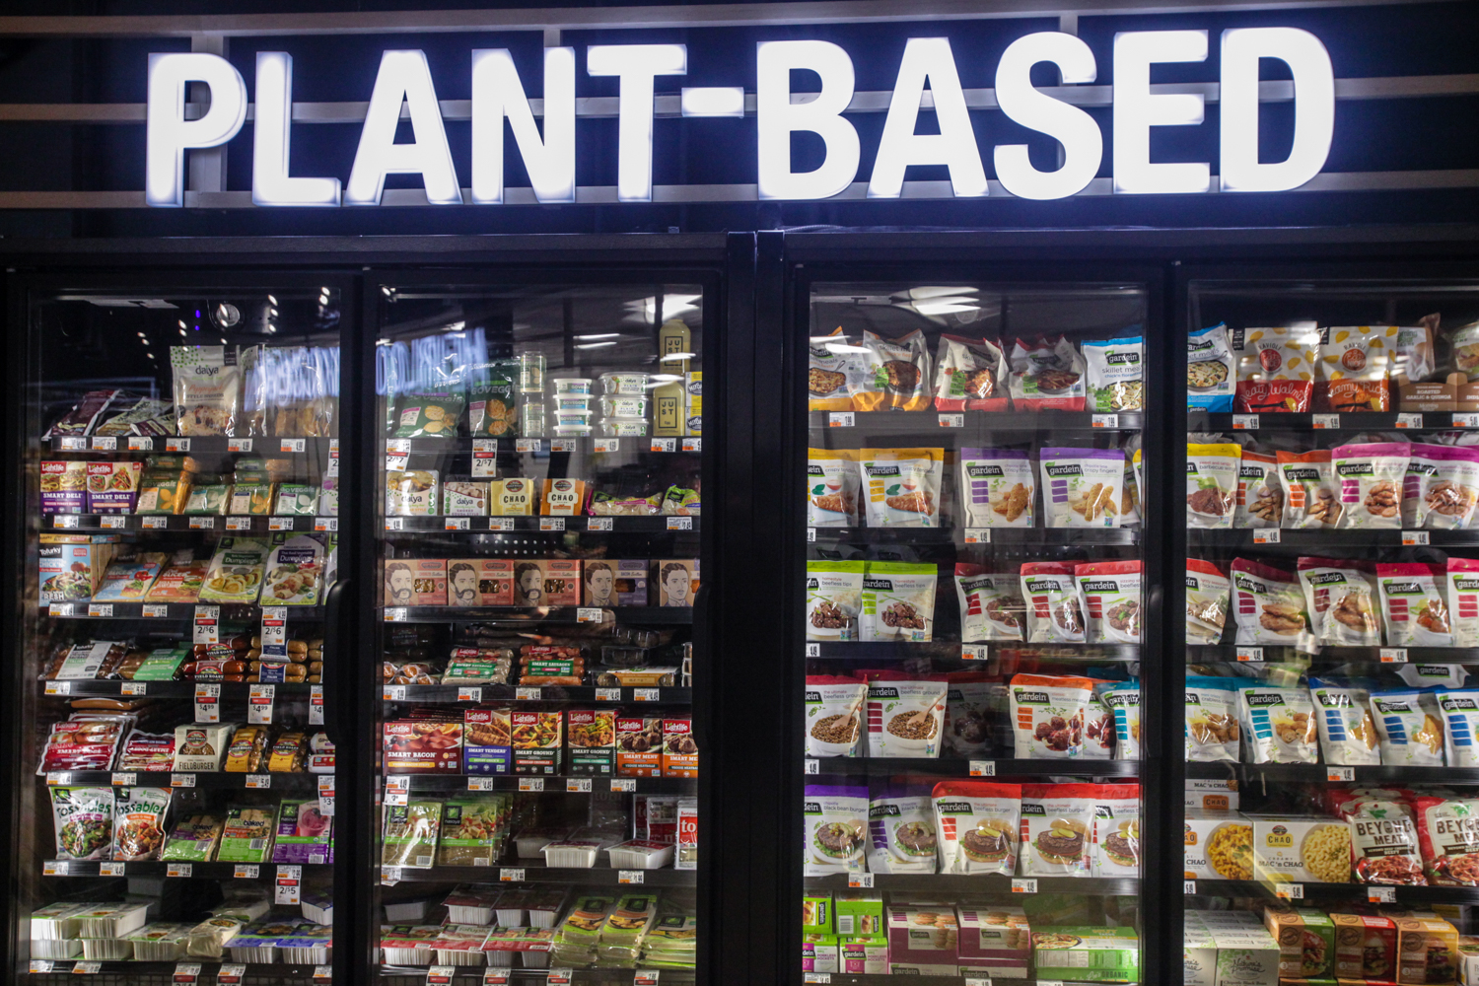
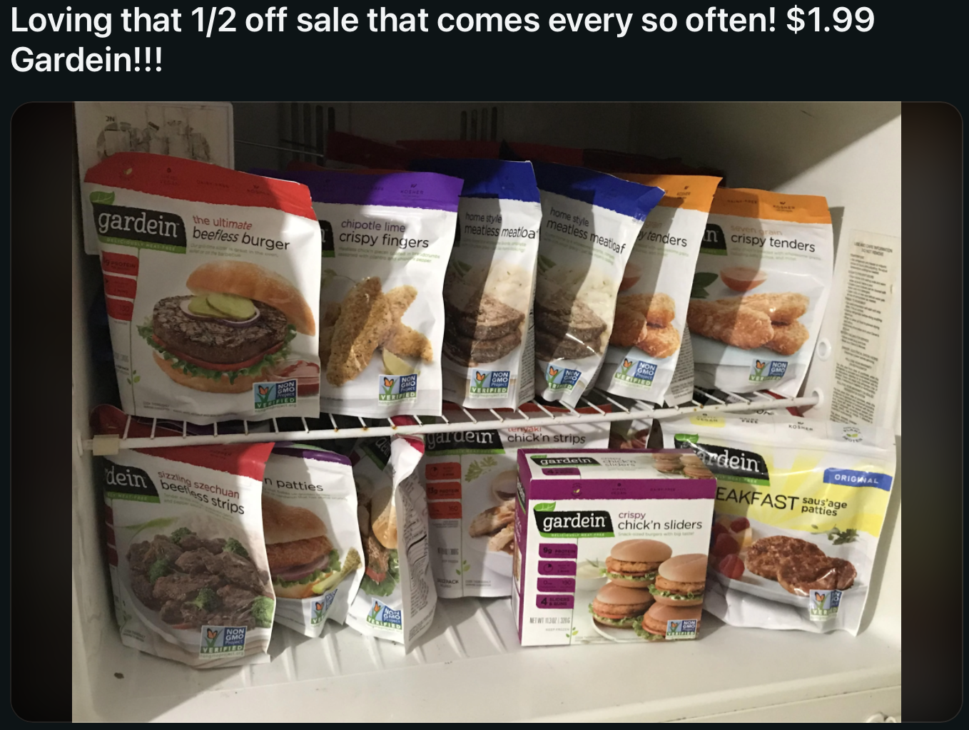
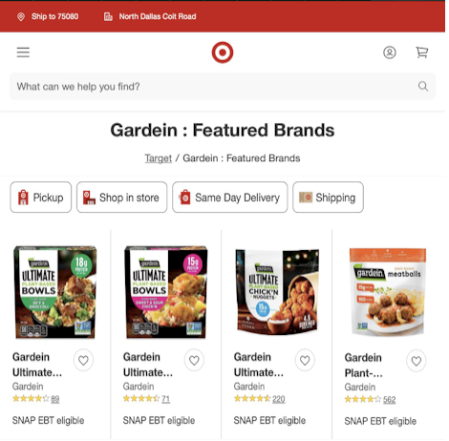

















Factors Affecting Sales
Form
Flavor
Promotions
Unit Reductions
Display
Price Reductions
Featured

Slide 5
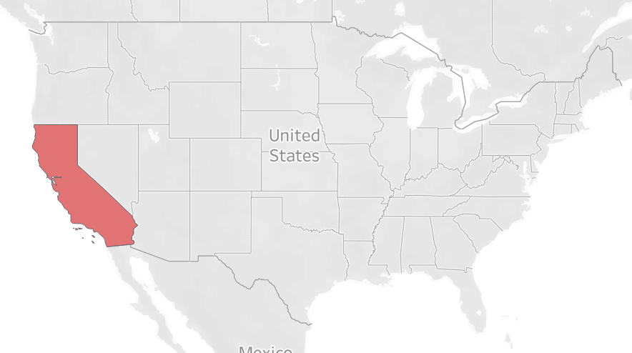
California Region Insights
Helping Sales
Promotions:
Price Per Unit Display Only and Unit Reductions Only
Form:
Ground and Meatball
Flavor:
Fresh and Asian
Form and Flavor:
Asian Fillets
Regular Patties
Grain Nugget forms
Hurting Sales
Form:
Patty and Sliced
Flavor:
Italian and Breakfast
Form and Flavor:
Any Flavored Nuggets

Slide 6
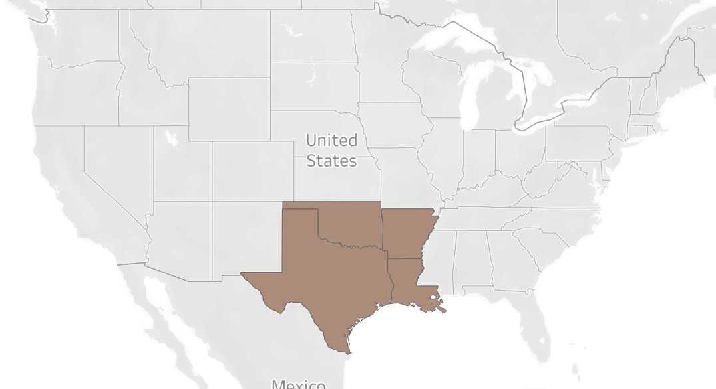
South Central Region Insights
Helping Sales
Promotions:
Unit Reduction & Display Only
Form:
Ground and Meatball
Flavor:
Grain and Asian
Form and Flavor:
Asian Filets
Regular Patties
Grain and Spicy Nuggets
Italian Sliced
Hurting Sales
Form:
Sliced and Patty
Flavor:
Fresh and Breakfast
Form and Flavor:
Spicy Patties
Regular Sliced

Slide 7
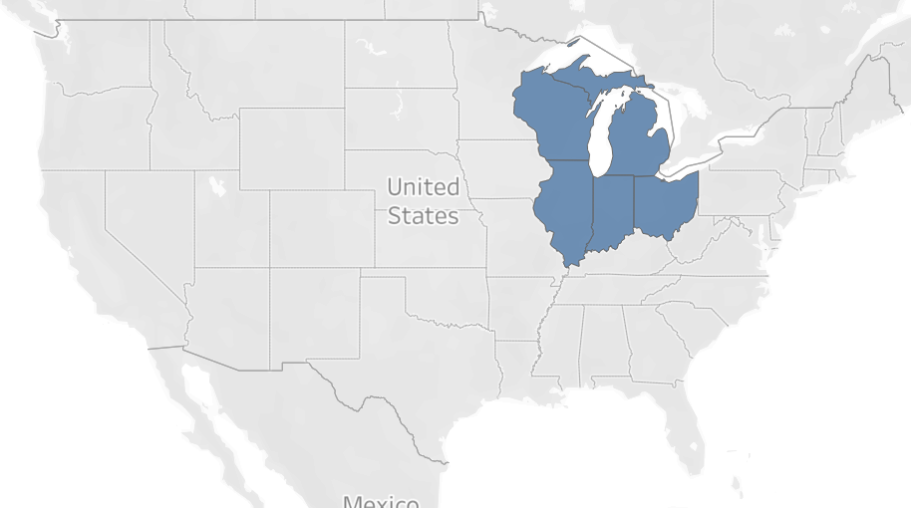
Great Lakes Region Insights
Helping Sales
Promotions:
All Promotions help Unit Sales most popular being: Price Per Unit Display Only & Feature Only
Form:
Ground, Meatball, & Nuggets
Flavor:
Grain, Fish, & Asian
Form and Flavor:
Asian Fillets
Regular Patties
Grain and Spicy Nuggets are most popular but all nugget flavors have a positive impact
Hurting Sales
Form:
Patty and Sliced
Flavor:
Fresh and Breakfast
Form and Flavor:
Regular flavored Nuggets
Spicy Patties
Pricing Strategy:
Price sensitive region
Ground, Meatball

Slide 8
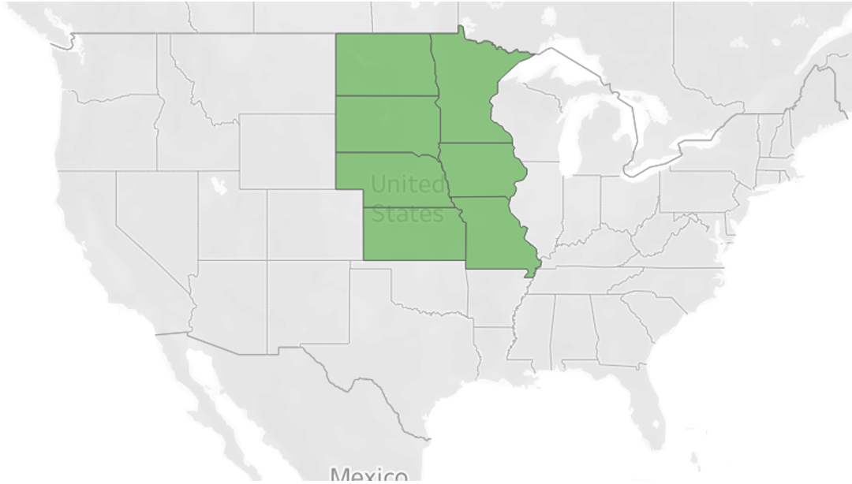
Plains Region Insights
Helping Sales
Promotions:
Unit Reductions & Display Only
Form:
Ground and Meatball
Flavor:
Grain and Asian
Form and Flavor:
Asian Filets
Grain and Spicy Nuggets
Hurting Sales
Promotions:
Feature and Display Only
Form:
Sliced , Nugget, Patty
Flavor:
Italian, Tex Mex, & Fresh
Form and Flavor:
Italian & Fresh Patties
Regular Nuggets

Slide 9
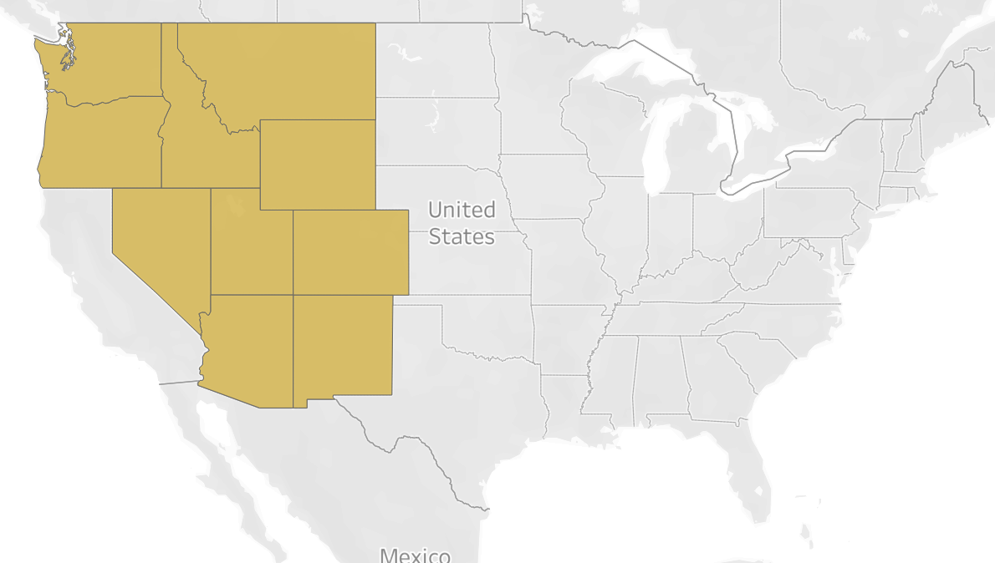
West Region Insights
Helping Sales
Promotions:
Feature Only, No Merch, Display Only
Form:
Ground and Meatball
Flavor:
Grain
Form and Flavor:
Asian Filets
Grain Nuggets
Hurting Sales
Form:
Sliced, Patty
Flavor:
TexMex
Form and Flavor:
All Patty Flavors
Notes:
Promotions:
Minimal impact on sales
Focus on FeatureOnly and Avoid AnyMerch
Form:
Most Positive Impact on Sales: Meatball, Ground
Most Negative Impact on Sales: Patty, Sliced
Flavor
Positive Sales Impact: Grain
Negative Impact on Sales: Tex Mex

Slide 10
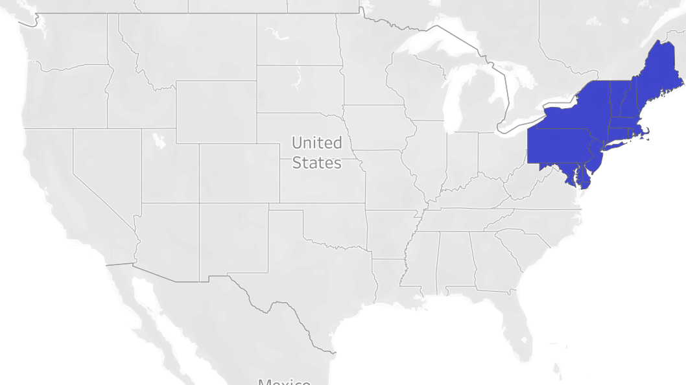
North East Region Insights
Helping Sales
Promotions:
No Merch, Display Only
Form:
Ground , Meatball, Nugget
Flavor:
Grain, Fish
Hurting Sales
Form:
Sliced, Patty
Flavor:
Fresh , Breakfast
Notes:
Promotions:
NoMerch has most positive sales impact,
followed by products on display only
AnyMerch has negative sales impact
Form:
Highest Positive Sales Impact: Ground, Meatball, Nugget
Negative Sales Impact: Patty, Sliced
Flavor:
Grain and Fish increase sales the most
Fresh and Breakfast decrease sales
Pricing Strategy:

Slide 11
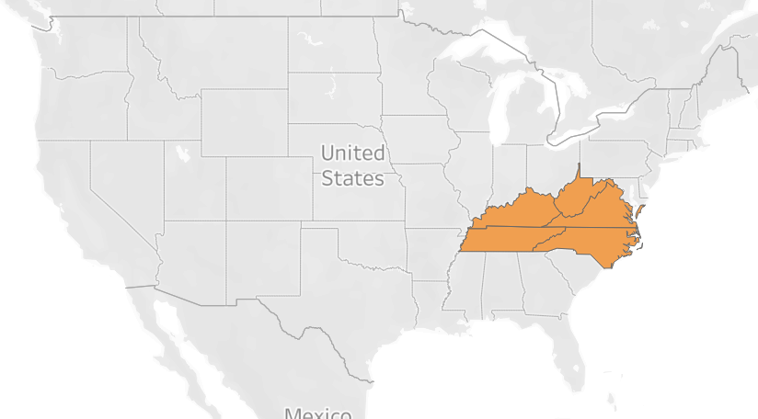
Midsouth Region Insights
Helping Sales
Promotions:
Display Only & Unit Reduction
Form:
Ground , Meatball, Nugget
Flavor:
Grain, Asian
Hurting Sales
Form:
Sliced, Patty
Flavor:
Fresh , Tex Mex
Notes:
Promotions:
Products on display increase sales considerably
Focus on NoMerch rather than AnyMerch
Form:
Highest Positive Sales Impact: Ground, Meatball, Nugget
Negative Sales Impact: Sliced, Patty
Flavor:
Grain has highest positive sales impact followed by Asian
TexMex and Fresh flavors negatively impact sales
Pricing Strategy:

Slide 12
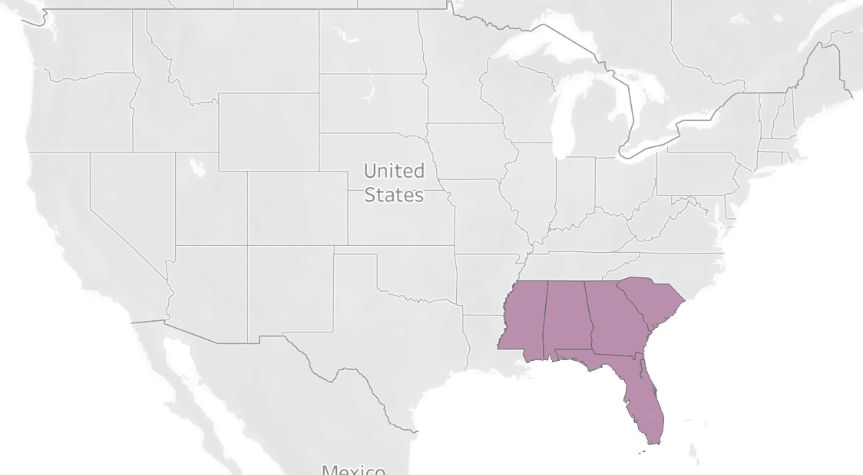
Southeast Region Insights
Helping Sales
Promotions:
Display Only, Feature and Display, Feature Only, Unit Reductions Only
Form:
Fillet, Meatball, Ground
Flavor:
Grain, Fish
Form and Flavor:
Asian Fillets, Regular Fillets
Grain Nuggets, Spicy Nuggets
Regular Patty
Italian Sliced
Hurting Sales
Form:
Patty
Flavor:
Fresh, Tex Mex
Form and Flavor:
Regular Nugget, Asian Nugget
Italian patty, Fresh Patty
Pricing Strategy:
Price Sensitive Region
Ground, Meatball

Slide 13
Conclusion
Overall Recommendation:
Conagra should adopt a region-specific approach for sales when it comes to price sensitivity, promotions and form/flavor varieties, rather than a 'one size fits all' marketing strategy.
Adopting a regional specific approach will allow for targeted market share improvement while maintaining the existing consumer base.
Key Takeaways
Using promotions has a consistent positive impact across regions.
Ground, Meatball varieties have the highest and most consistent positive impact on sales across all regions.
Flavors like Grain and Asian contribute to sales growth as well.
Pricing strategies vary by region, with price sensitivity most notable in the Great Lakes and Southeast regions, necessitating a cautious approach when increasing per-unit prices.

